Slide 1

ONLINE VOTING SYSTEM
By G . Mahitha
21761A5484

Slide 2
PROBLEM STATEMENT
Voting is not done 100% perfectly because of some reasons like technical issues ,security
issues to the ballet box ,and voters are unable to reach the voting booth etc; at that
time 100% voting is not done

Slide 3
INTRODUCTION
An online voting system is a platform that allows organizational members to cast their votes electronically, which can be through a website, mobile app, or any internet-connected device.
Materials :HTML,CSS,JQUREY
content
Home
Login
Registration
Dashboard
Contact us
About us

Slide 4
TECHNOLOGIES
I have used different languages to design this website.
HTML
CSS
JQUERY
These are the above technologies use in my website.

Slide 5
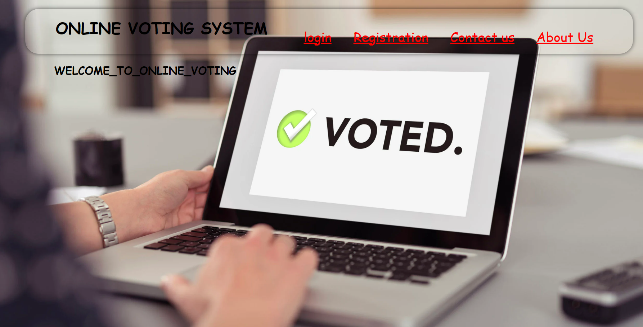
HOME PAGE
Home page consists of following links:
Login
Registration
Contact us
About us

Slide 6
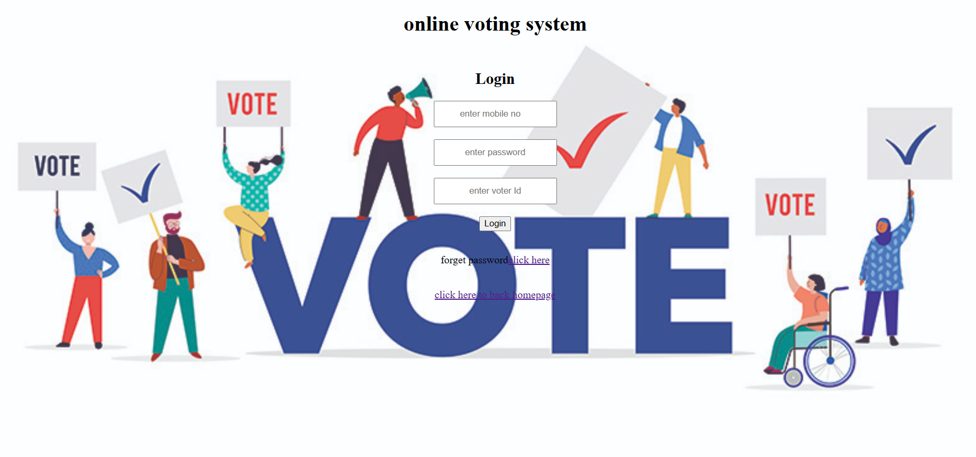
LOGIN FORM
MOBILE NO
PASSWORD
VOTER ID
After enter your details click login
If u forgot your password click here

Slide 7
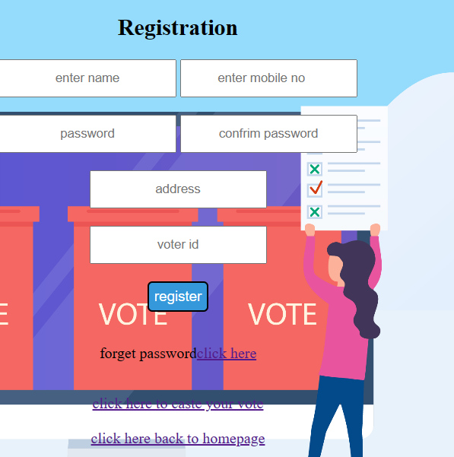
REGISTRATION
In registration form enter your name
Enter mobile no , password, confirm password ,address , voter id
After fill all the details click register button
If you forgot your password click here
After you caste your vote
Click caste your vote then it got to caste your vote website

Slide 8
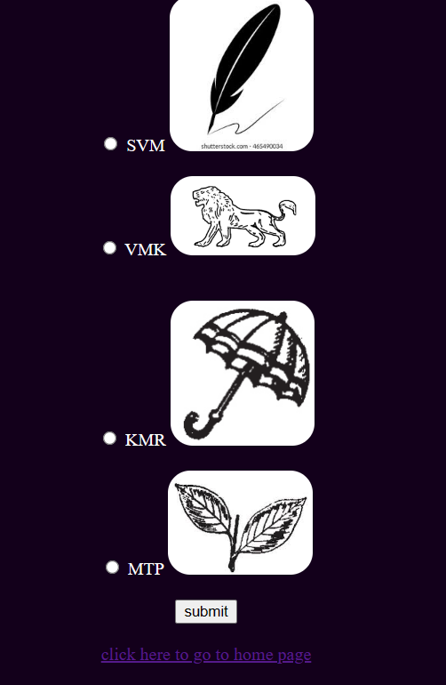
DASHBOARD
In registration form click caste your vote it goes to caste your vote dashboard.
In dashboard select any one of the party
After select click submit
And then go to homepage click homepage

Slide 9
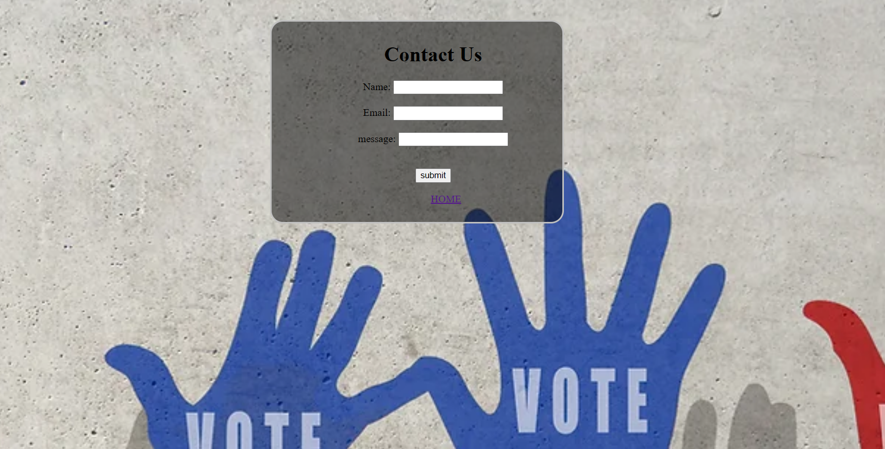
CONTACT US

Slide 10
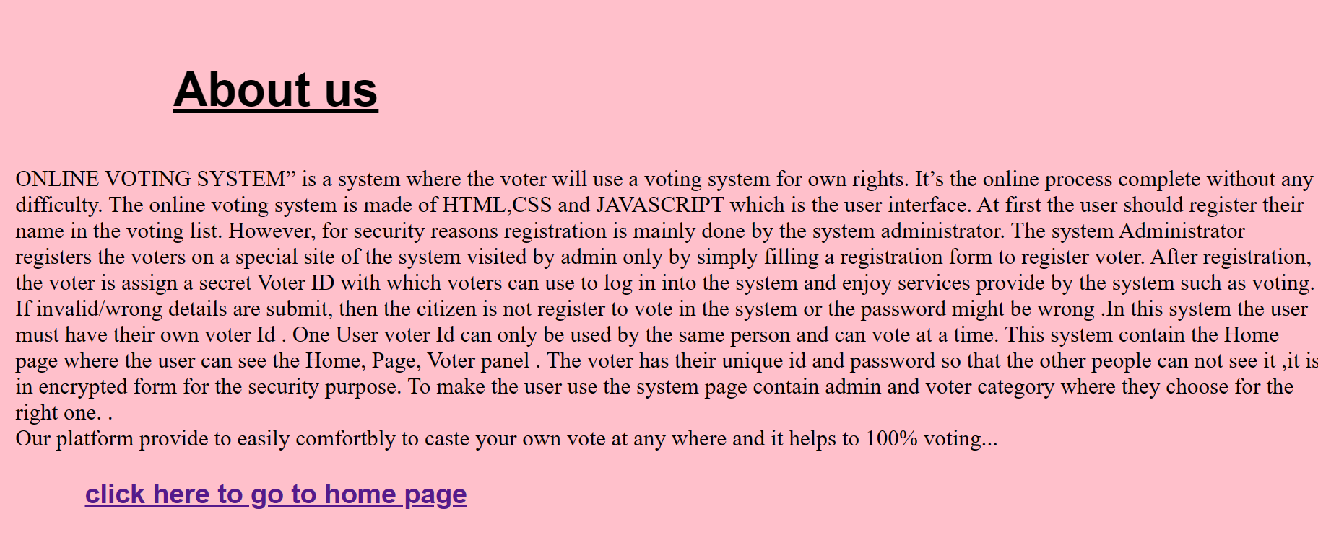
ABOUT US

Slide 11
OBSERVATIONS
In Todays voting system has some problems like high budget , security , some voters are unable to reach the polling booth etc.
Based on above problems to solve this to create a online voting system.
In online voting system is a software web application platform using HTML,CSS,JQUERY.
By using above languages create a online voting system.
ONLINE VOTING is a software platform that provides security and you can caste
Your vote at any where in mobile or laptop it helps to decrease the budget to conduct Elections ,reduce time .
In this web application helps to save money , time ,provide security etc.

Slide 12
CONCLUSION
ONLINE VOTING is a software platform that provides security and you can caste Your vote at any where in mobile or laptop it helps to decrease the budget to conduct Elections ,reduce time.
The advantages of online voting systems include increased efficiency, improved accuracy, and greater voter engagement compared to paper ballots and EVMS.

Slide 13
THANK YOU

